Slide 1
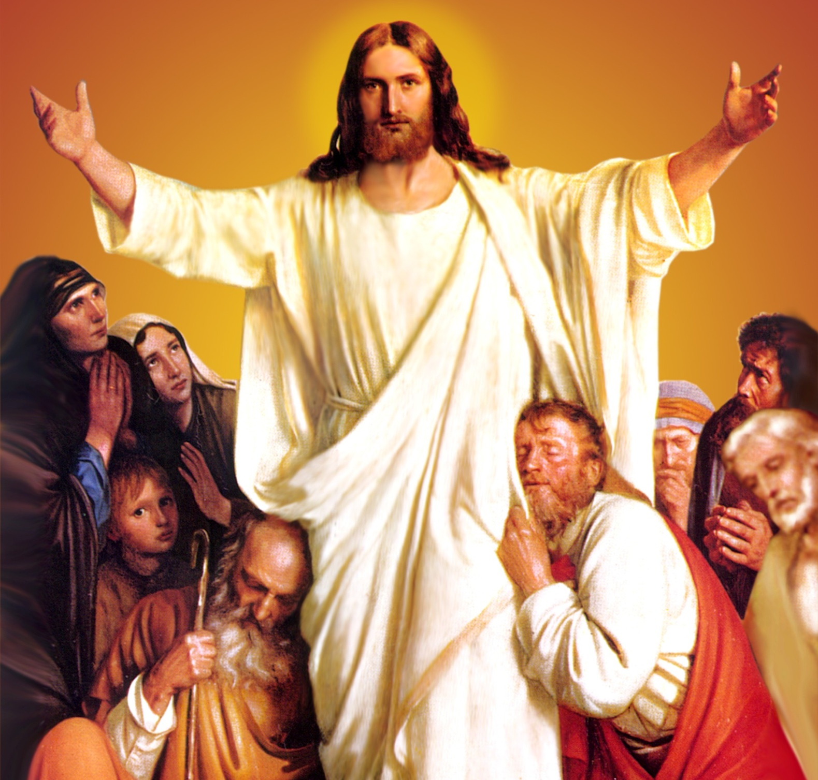
CATECHETICAL TEXTBOOK SERIES OF THE SYRO - MALABAR CHURCH
ON THE PATH OF SALVATION - 6
PEOPLE WHO
EXPERIENCED JESUS
6

Slide 2
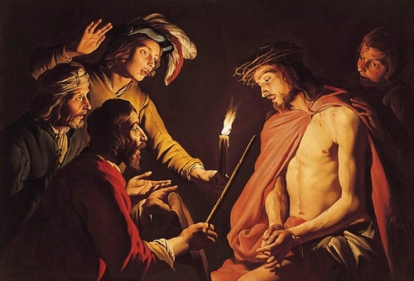
LESSON 9
JESUS WHO TAUGHT US FORGIVENESS

Slide 3
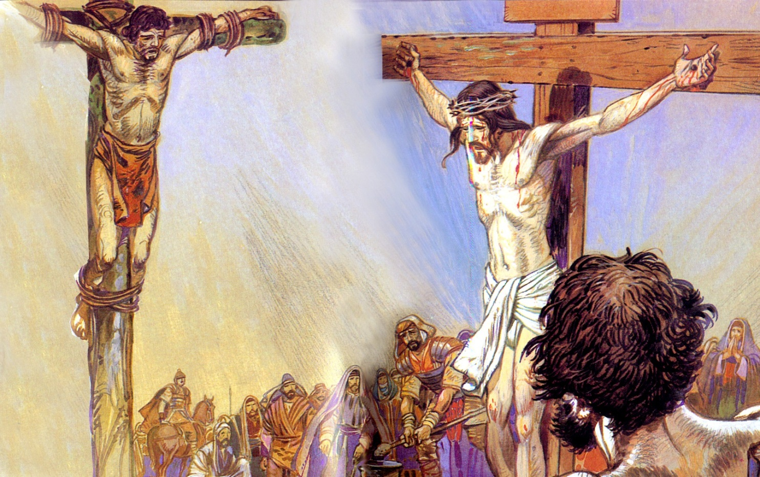
Jesus showed us a good example even during the great agony on the cross. Jesus interceded with his Father for those who tortured him so cruelly. Lying on the cross he prayed, “Father forgive them, they do not know what they do” (Lk. 23: 34). By forgiving and praying for those who hurt him by whip lashes, crown of thorns, ridicules and crucifixion, Jesus sets before us the great example of practicing his teaching, 'love your enemies'.

Slide 4
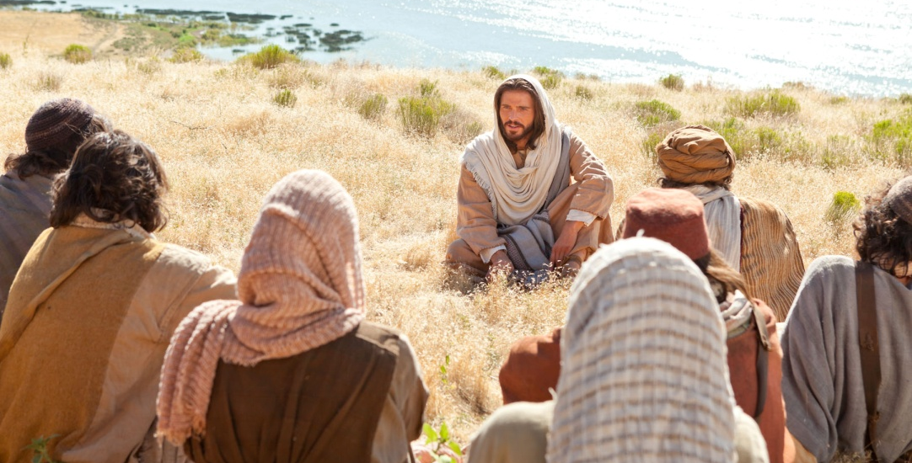
NEW TEACHING
Till the time of Jesus the law was, “an eye for an eye”, “a tooth for a tooth”. But Jesus rectified this law. Jesus taught, “If any one strikes your right cheek, turn the other also, and if anyone forces you to go one mile, go also the second mile” (Mt. 5: 39- 41). Jesus taught, “Love your enemies and pray for those who torment you”. He assured us that by following this teaching we shall become children of the heavenly father who let the sun rise over the good and the bad people and who makes the rain fall on the righteous and on the unrighteous.

Slide 5
Jesus asks: “For if you love those who love you what reward have you? Do not even tax collectors do that? And if you greet only your brothers and your sisters, what more are you doing than others? Do not even Gentiles do the same?” (Mt. 5: 46- 47). Jesus hopes that his disciple would behave in a much better way than what is generally done. He said: “For I tell you, unless your righteousness exceeds that of the scribes and Pharisees, you will never enter the kingdom of heaven” (Mt. 5: 20). Perfection is what he wants of us, for he says, “Be perfect as your heavenly father is perfect” (Mt. 5: 48).

Slide 6
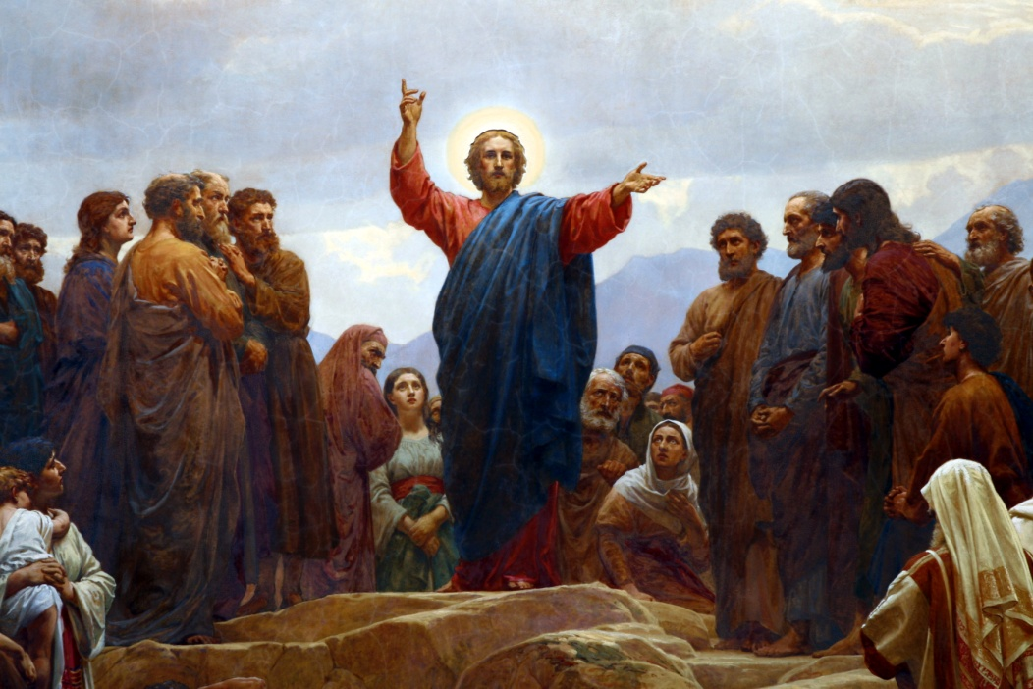
FORGIVENESS WITHOUT CONFINES
Jesus taught us that we should not put limits to forgiveness. Once, representing the disciples, Peter asked Jesus, “Master, how many times should we forgive? Seven times?” Jesus replied, “Not seven, but seventy times seven” (Mt. 18: 21- 22). By this Jesus meant that our forgiveness should have no limits. The teaching of Jesus is that even if a person approaches you several times a day for forgiveness, each time you must be prepared to forgive.

Slide 7
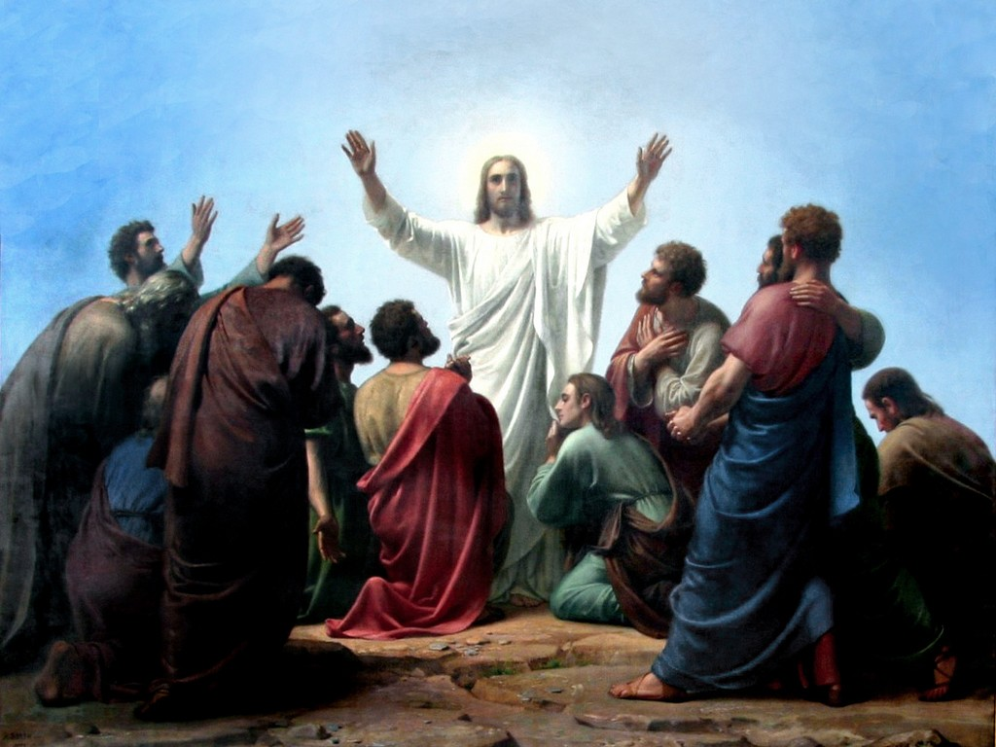
RELIEF FROM DEBTS
In the Lord's Prayer we request, 'Forgive us our debts, as we also have forgiven our debtors'. For God to forgive our numerous sins, we should forgive the wrongs that others do to us. Jesus has tried to make this truth clear by a beautiful parable described below.

Slide 8
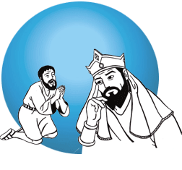
A king had a servant who owed him ten thousand talents. When he was unable to repay the debt in due time, the king ordered all his property to be sold to raise the money for the payment. But that servant fell on his knees before the king and begged, “Lord, forgive me. I shall pay all my debts.” The king feeling pity for him wrote off all his debt. But the same servant, as he came out, saw a fellow servant who owed him a hundred denarii, (100 denarii is much less in value than even 1 talent) and seizing him by the throat, he said, “Pay what you owe me.” This servant pleaded with him saying, “Have patience with me, and I will pay you”. But he refused. Then he threw him into the prison until he would pay the debt.
The king, who came to know of this from other servants, summoned him and said to him, “You wicked slave! I forgave you all that debt because you pleaded with me. Should you not have had mercy on your fellow slave?” And in anger his lord handed him to be tortured till he paid his debt.” After narrating this parable Jesus tells us, “So my heavenly Father will also do to every one of you, if you do not forgive your brother or sister from your heart” (Mt. 18: 35).

Slide 9
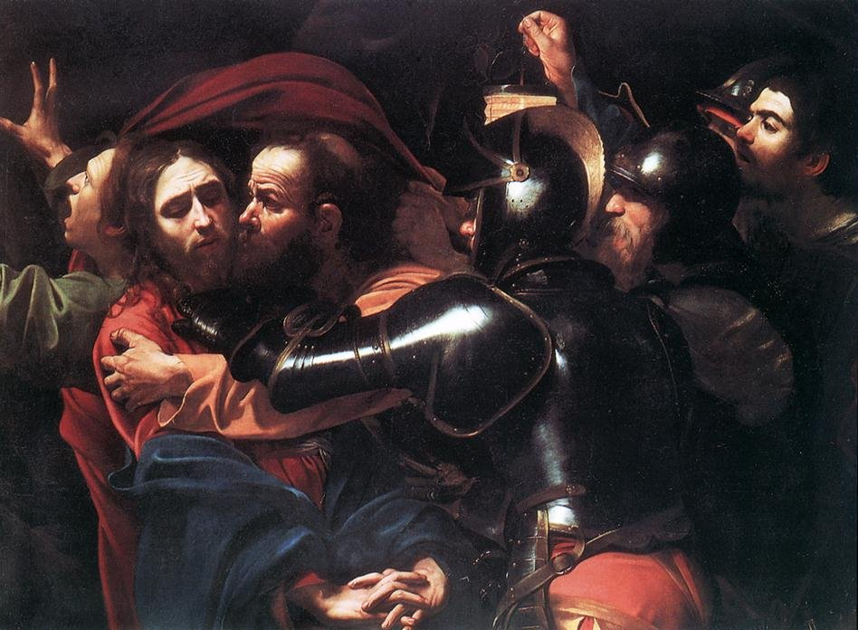
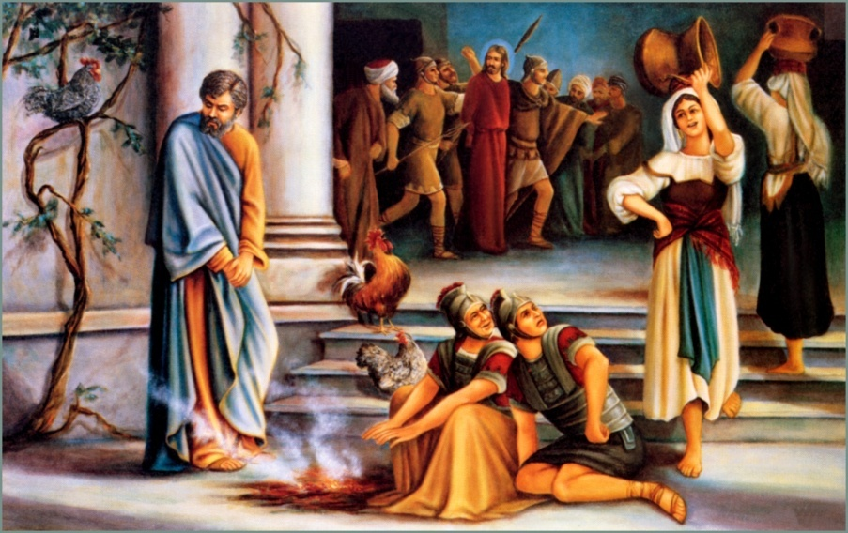
THE EXAMPLE OF JESUS
Jesus taught us to forgive, not just through his words, but through his example as well. He treated with tolerance those scribes and Pharisees who were forever accusing him and judging him. He mercifully forgave the sins of all who came to him or were brought to him. He addressed Judas, who came to betray him by a kiss, as 'friend'. He made Peter, who denied Jesus three times, the head of his church. Above all, he forgave completely those who crucified him and prayed for them.

Slide 10
Of the two who were crucified with Jesus, when the one on the left ridiculed him, the other rebuked him and said to Jesus, “Remember me when you are in your kingdom” (Lk. 23: 42). Jesus forgave all his sins and promised, “Today you shall be in paradise with me”.

Slide 11
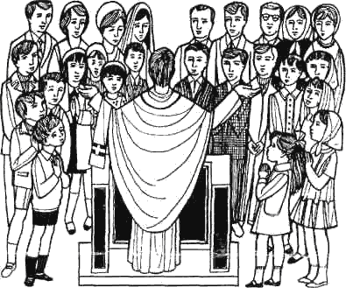
SACRIFICE AND FORGIVENESS
We can offer the sacrifice only with a mind of reconciliation, having forgiven everyone. Sacrifices offered without forgiveness, keeping hatred in mind, will not be acceptable before God. Before the supreme sacrifice on Calvary Jesus forgave his enemies when he was lying on the cross. Jesus says in the Sermon on the Mount, “When you offer the gift at the altar, if you remember that your brother or sister has something against you, leave the gift there before the altar and go; first be reconciled to your brother or sister, and then come and offer the gift” (Mt. 5: 23- 24).

Slide 12
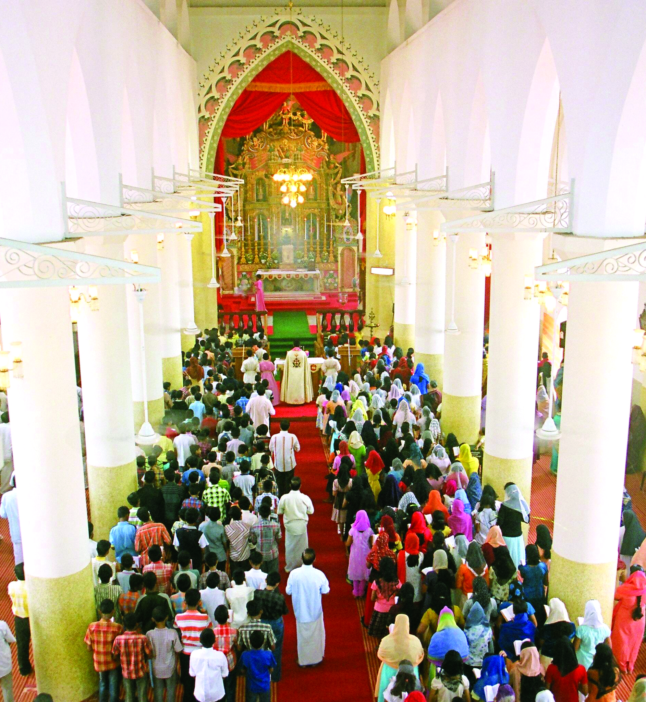
The first hymn in our Holy Mass reminds us of the need for reconciliation. We sing...
'Let us all be reconciled
And prepare a new altar
With the love of Lord Jesus
Let us offer this sacrifice.
In this hymn, we are declaring that we have no enmity to any one and that we stand there with a reconciled mind, having forgiven everyone. At this moment if we have ill will towards any one, we must forgive it there itself in our heart and thus become worthy to offer the sacrifice. The rite of reconciliation and the offering of peace to each other, serve as reminder to us that we must forgive one another. By offering peace to one another we imply that we have no hatred to any one. During the Karosusa prayer we ask God for the grace to offer the sacrifice with a clear conscience, giving up quarrels and differences, and freeing the soul from hatred and enmity.
St. Paul advises us, “Just as the Lord has forgiven you, so you also forgive one another (Col. 3: 14). Following the teachings and examples of Jesus, let us also practice forgiveness.

Slide 13
Let us pray
O! Jesus, who prayed on the cross for those
who crucified you, help us
to overcome evil by goodness.

Slide 14
Read the word of god:
Mathew 18:21-35

Slide 15
WORD OF GOD FOR GUIDANCE
"If you forgive others their trespasses, your heavenly
Father will also forgive you" (Mt.6:14).

Slide 16
LET US DO:
Write about an incident where you received
happiness by forgiving someone.

Slide 17
MY DECISION
I will forgive those who offend me
instead of taking revenge.

Slide 18
LET US Find out the answer
1. How did Jesus give the model for the loving of enemies?
2. What was the answer Jesus gave to Peter when asked how many times one should forgive others?
3. What is the message the parable of the unforgiving servant gives us?
4. What is Jesus’ teaching about the right disposition before the offering of the sacrifice?
5. Which hymn in the Holy Qurbana commemorates the act of reconciliation?

Slide 19
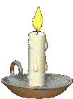
Thank you

